Slide 1

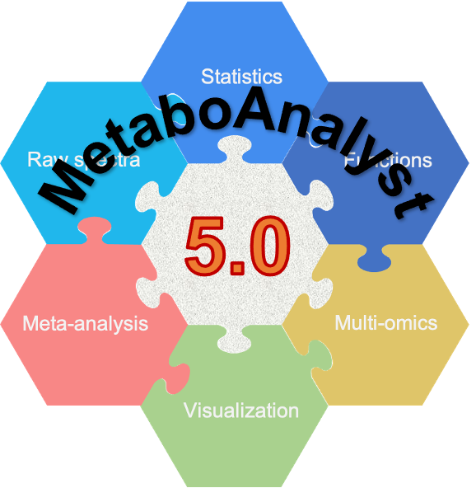

Spectra processing, statistical analysis and functional integration using MetaboAnalyst 5.0
Jianguo (Jeff) Xia, Associate Professor
jeff.xia@mcgill.ca | www.xialab.ca
McGill University, Montreal, QC Canada
June 19, 2023

Slide 2


Acknowledgements

Slide 3
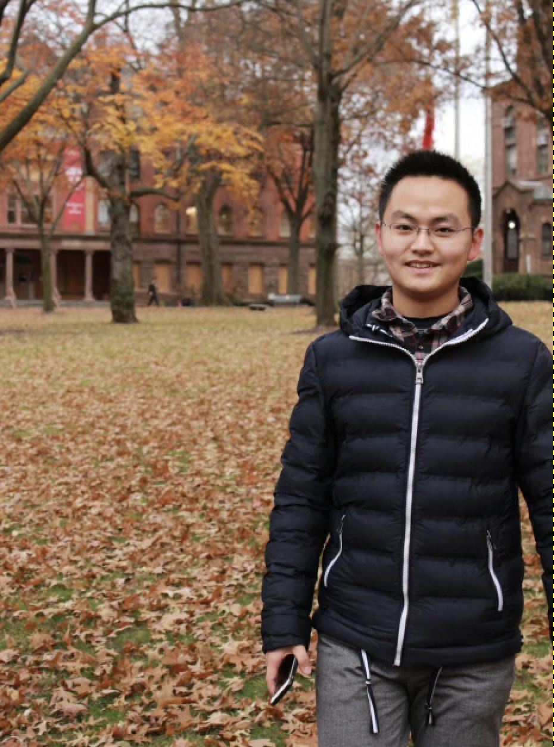
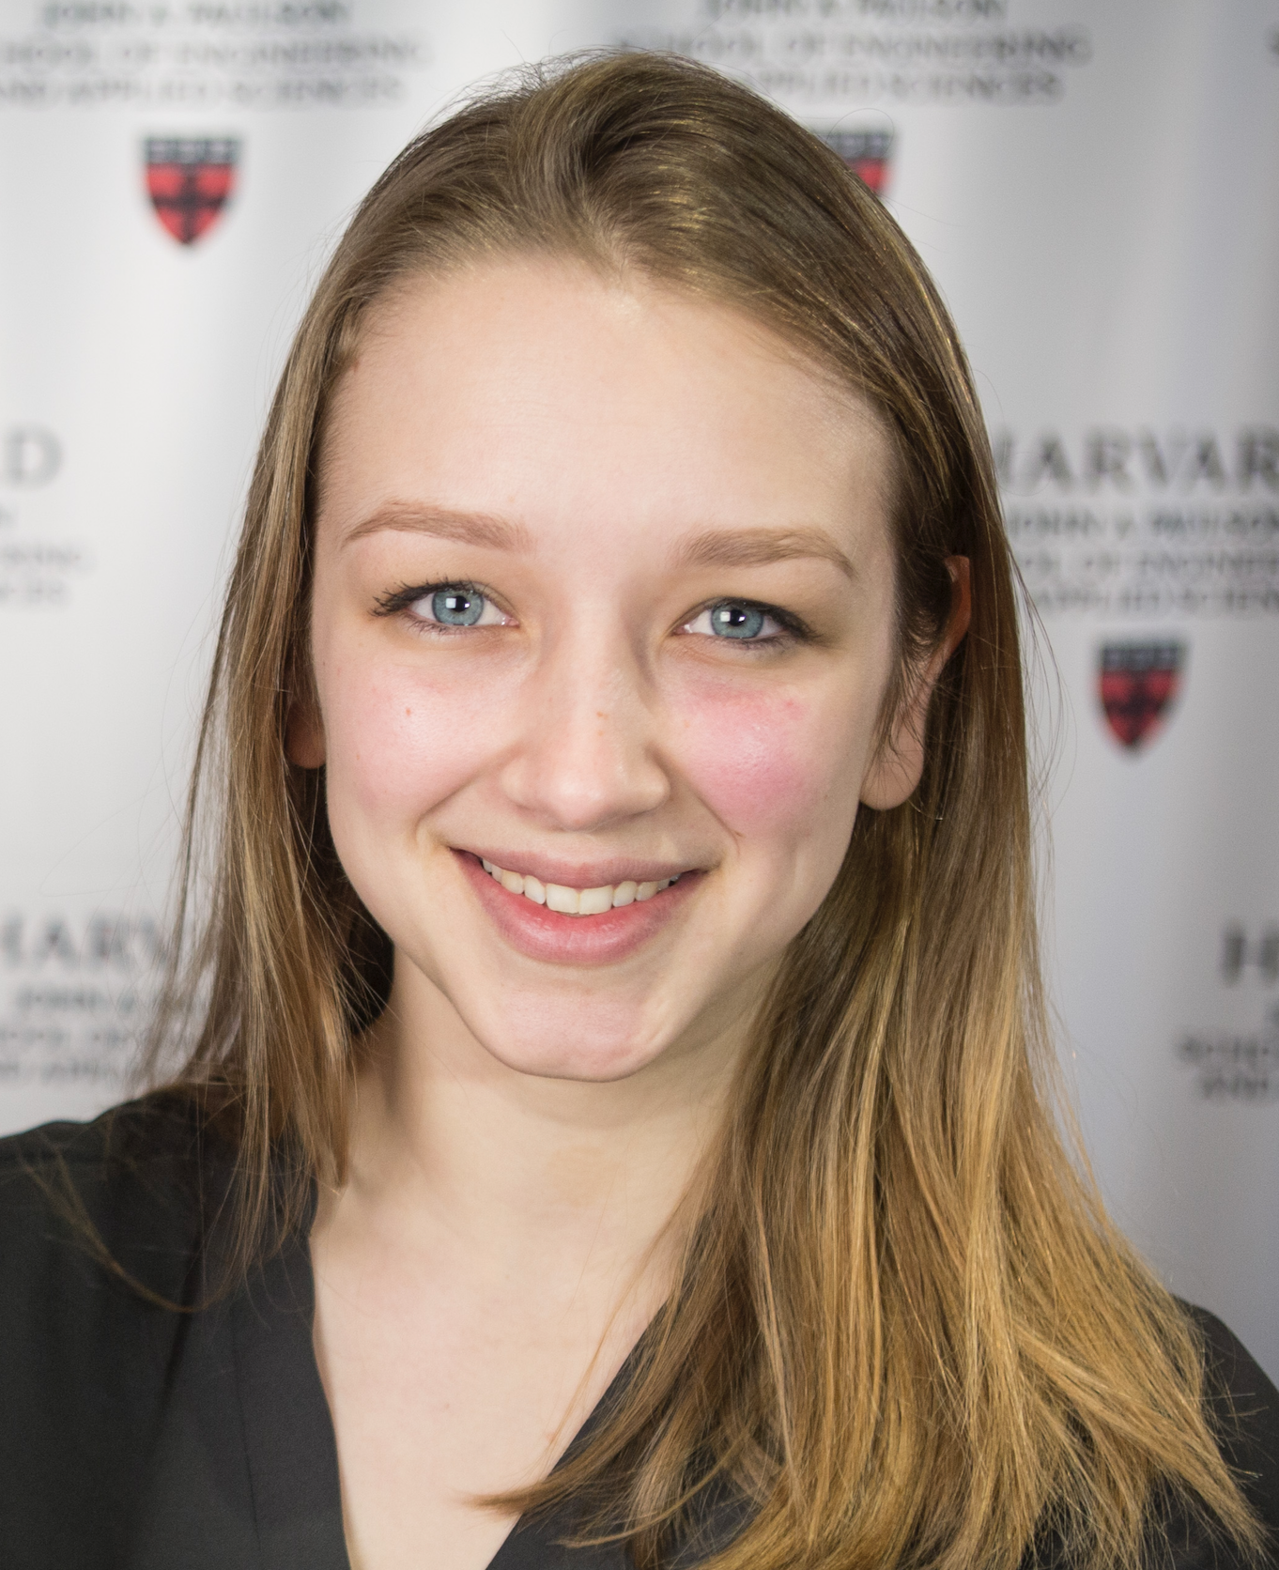

Your TAs
Qiang
Jessica
Yao

Slide 4
Schedule
Part I: 8:15 AM – 10:15 PM
8:15 – 8:30: Opening lecture (Jeff)
8:30 – 8:50: Section 1: LC-MS spectral processing (Qiang)
8:50 – 9:15: Section 1: Hands on
9:20 – 9:45: Section 2: Stats I – simple experimental design (Jessica)
9:45 – 10:15: Section 2 Hands on
Part II: 10:30 AM – 12:30 PM
10:30 – 10:50: Section 3: Functional analysis (Yao)
10:50 – 11:10: Section 3: Hands on
11:15 – 11:40: Section 4: Stats II - complex experimental design (Jessica)
11:40 – 12:15: Section 4: Hands on
12:15 – 12:30: Summary (Jeff)

Slide 5
A Gentle Introduction to Key Concepts in ‘Omics Data Analysis

Slide 6
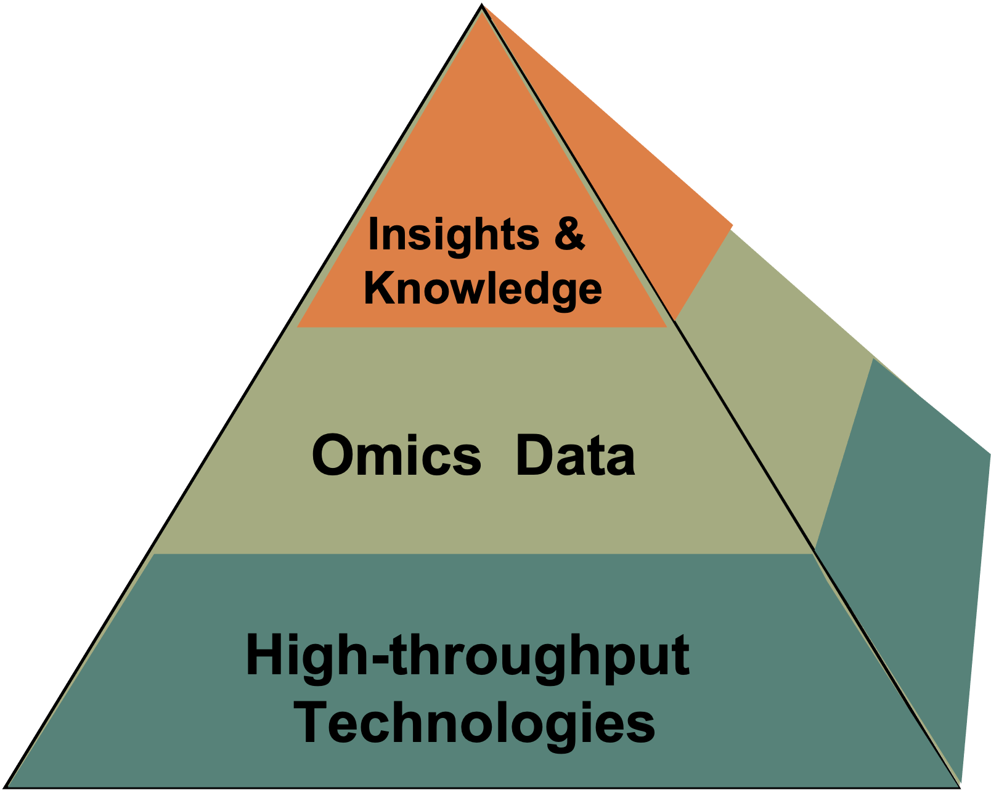
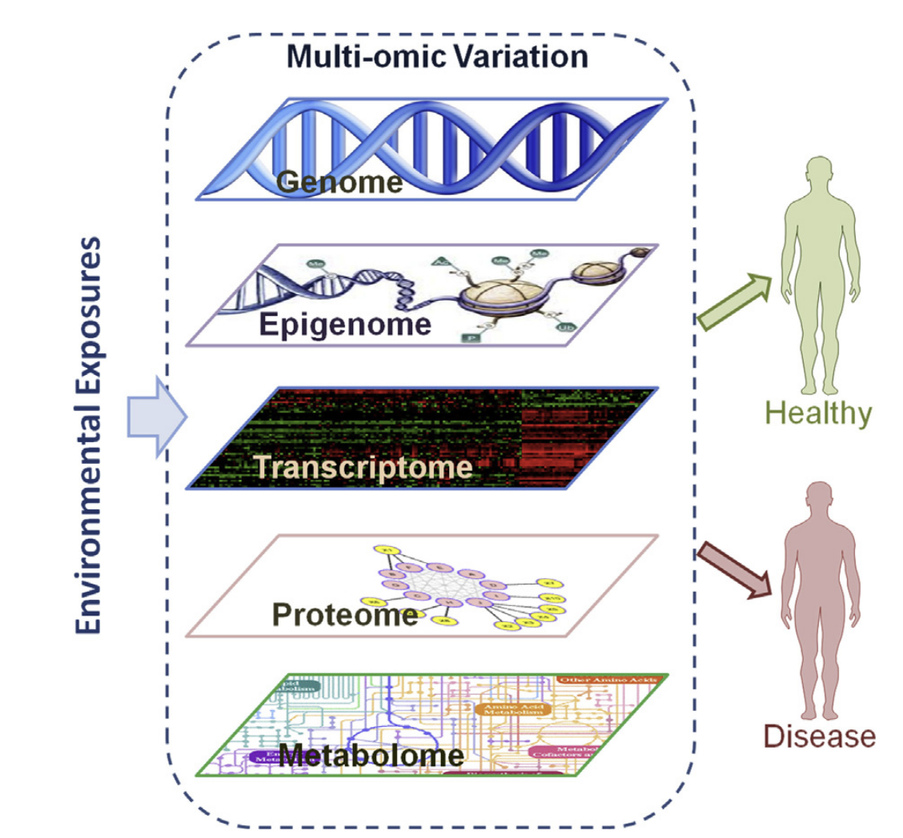
Omics & multi-omics era

Slide 7

Two distinct challenges
Size challenge (raw data)
Raw reads, spectra, images
Large (GB ~TB)
Large storage and computing resources
Complexity challenge (feature table)
Feature table (abundance, intensities)
Small (100s KB ~ MB)
High-dimensional, missing values
Data analysis starts here

Slide 8
Omics data analytics framework
Raw data
Data table
Distilled data
Insights
Notes:
Most data analytics practices can be codified and re-used
Reproducible research
Most studies & data sets are small to medium
Context specific (~100M is small now ….)
Relative to computing power
Can be finished in minutes ….
Access to computing is generally random
Critical for web-based platform

Slide 9
Omics Data Analysis (in a nutshell)
From raw spectra to a data table
Raw data preprocessing
Data processing & normalization
Prepare data table for analysis
Significant features & patterns
Statistical analysis & visualization
Insights & hypothesis
Functional interpretation
Notes:
Clustering to group the samples.features by their internal similarities (unsupervised classification)
Classification is to group samples / features guided by their phenotype labels (supervised).

Slide 10
Common steps in omics workflow
Data processing
Quality checking
Missing values
Filtering
Normalization
Statistics
Univariate analysis
Dimension reduction
Machine learning
Clustering
Classification
Data interpretation
Enrichment analysis
Network analysis

Slide 11

Don’t forget biology & context
Statistics
Data Summary
Domain Knowledge
Omics Data
What we know
Visualization
Put everything together and write your manuscript

Slide 12
Journey of MetaboAnalyst
2021
v1.0 Statistical
v2.0 Functional (targeted)
v3.0 Translational (targeted)
v4.0 Functional (untargeted)
v5.0
Spectra analysis (untargeted)
2018
2015
2012
2009

Slide 13
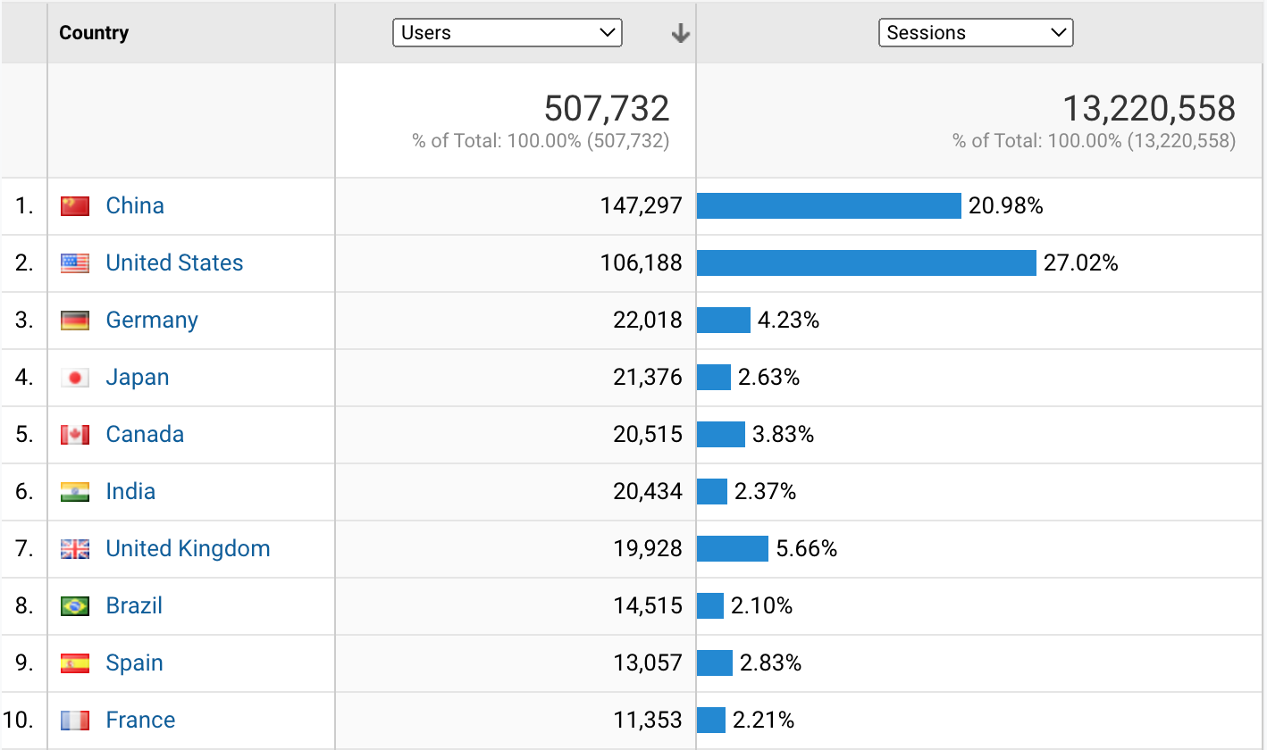
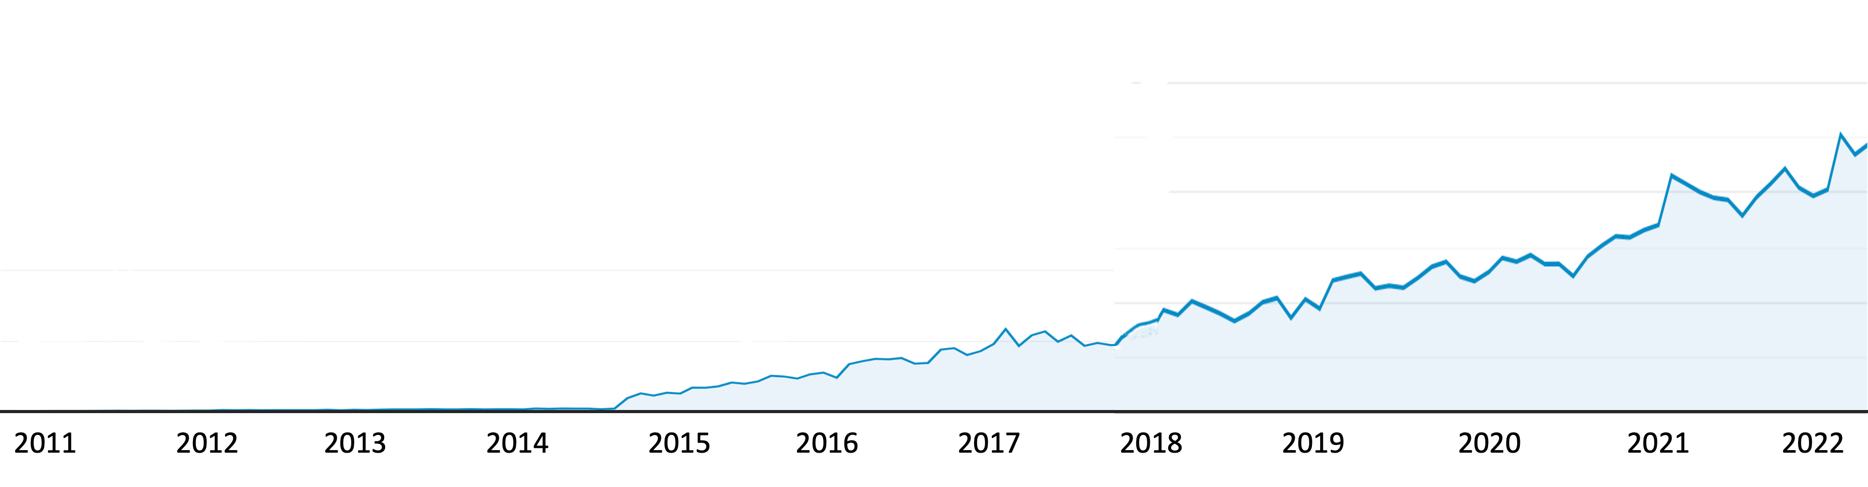
User Traffic (Google Analytics)
30,000 users/month
~ 2,500 users per day
Since 2018, >13 million data analysis jobs submitted from ~500, 000 users
300 ~500 users/month

Slide 14
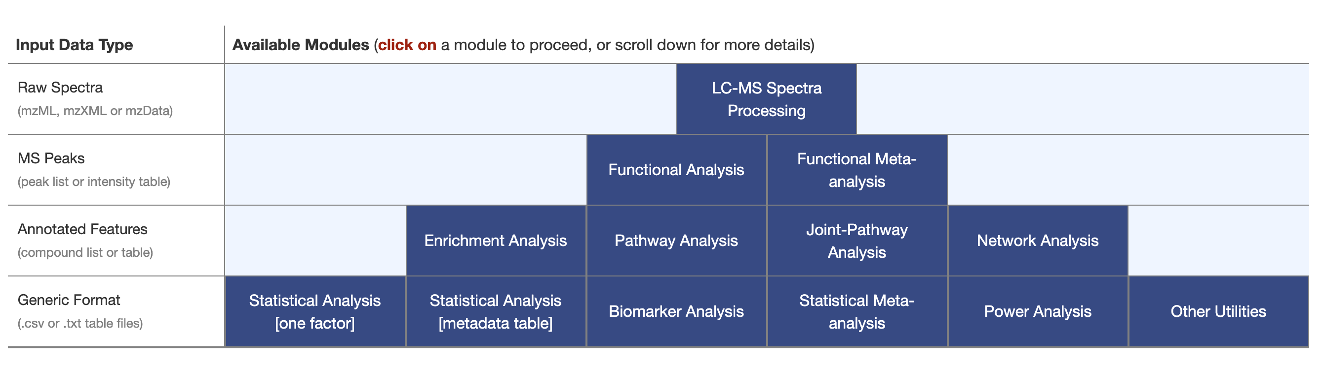
MetaboAnalyst 5.0 Modules
Section 1
Section 3
Section 2
Section 4

Slide 15
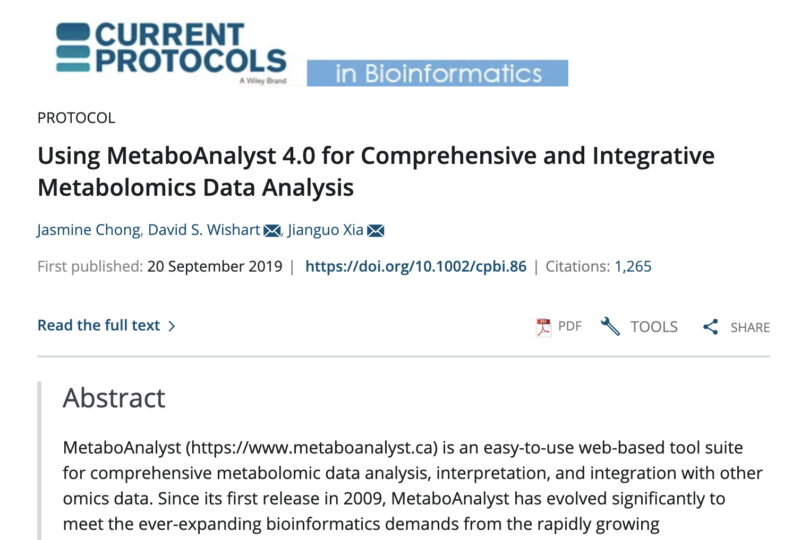
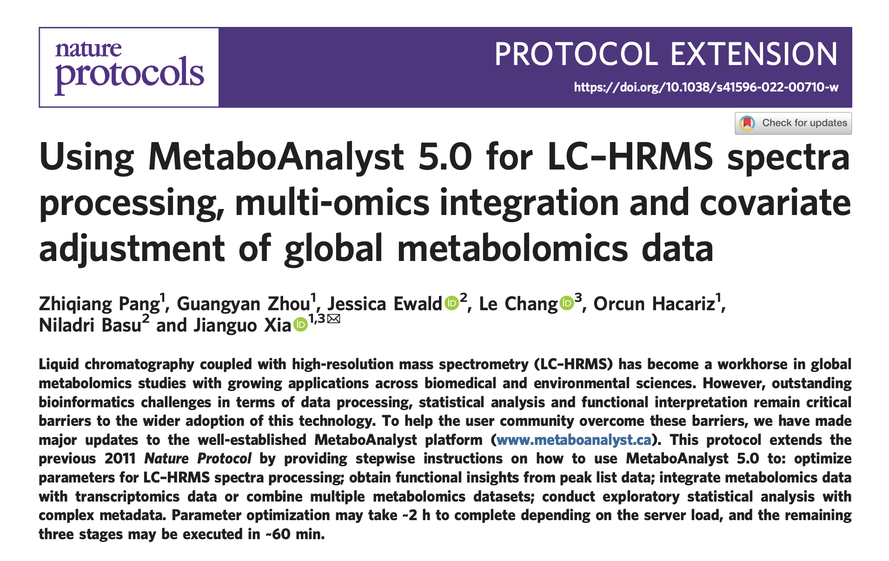
Detailed protocols
https://github.com/xia-lab/Metabolomics_2023

Slide 16
Logistics

Slide 17
MetaboAnalyst 5.0 Workshop Checklist
Wifi Account: Metabolomics 2023
Code: Falls2023
Instructions & Materials:
https://github.com/xia-lab/Metabolomics_2023
We have set up multiple servers:
https://www.metaboanalyst.ca
https://new.metaboanalyst.ca
https://genap.metaboanalyst.ca
User Forum:
https://omicsforum.ca

Slide 18
Cautions & Recommendations
Page display may be slow due to bandwidth limitation in this room
Be patient
Do not open multiple tabs to MetaboAnalyst (results will overwrite each other!)
Form a group and share computers (see next page)

Slide 19
Group forming
2~3 people per group
Make new friends
Help each other & reduce stress
Share laptops
One for displaying tutorial, and one for using MetaboAnalyst
Reduce bandwidth consumption

Slide 20
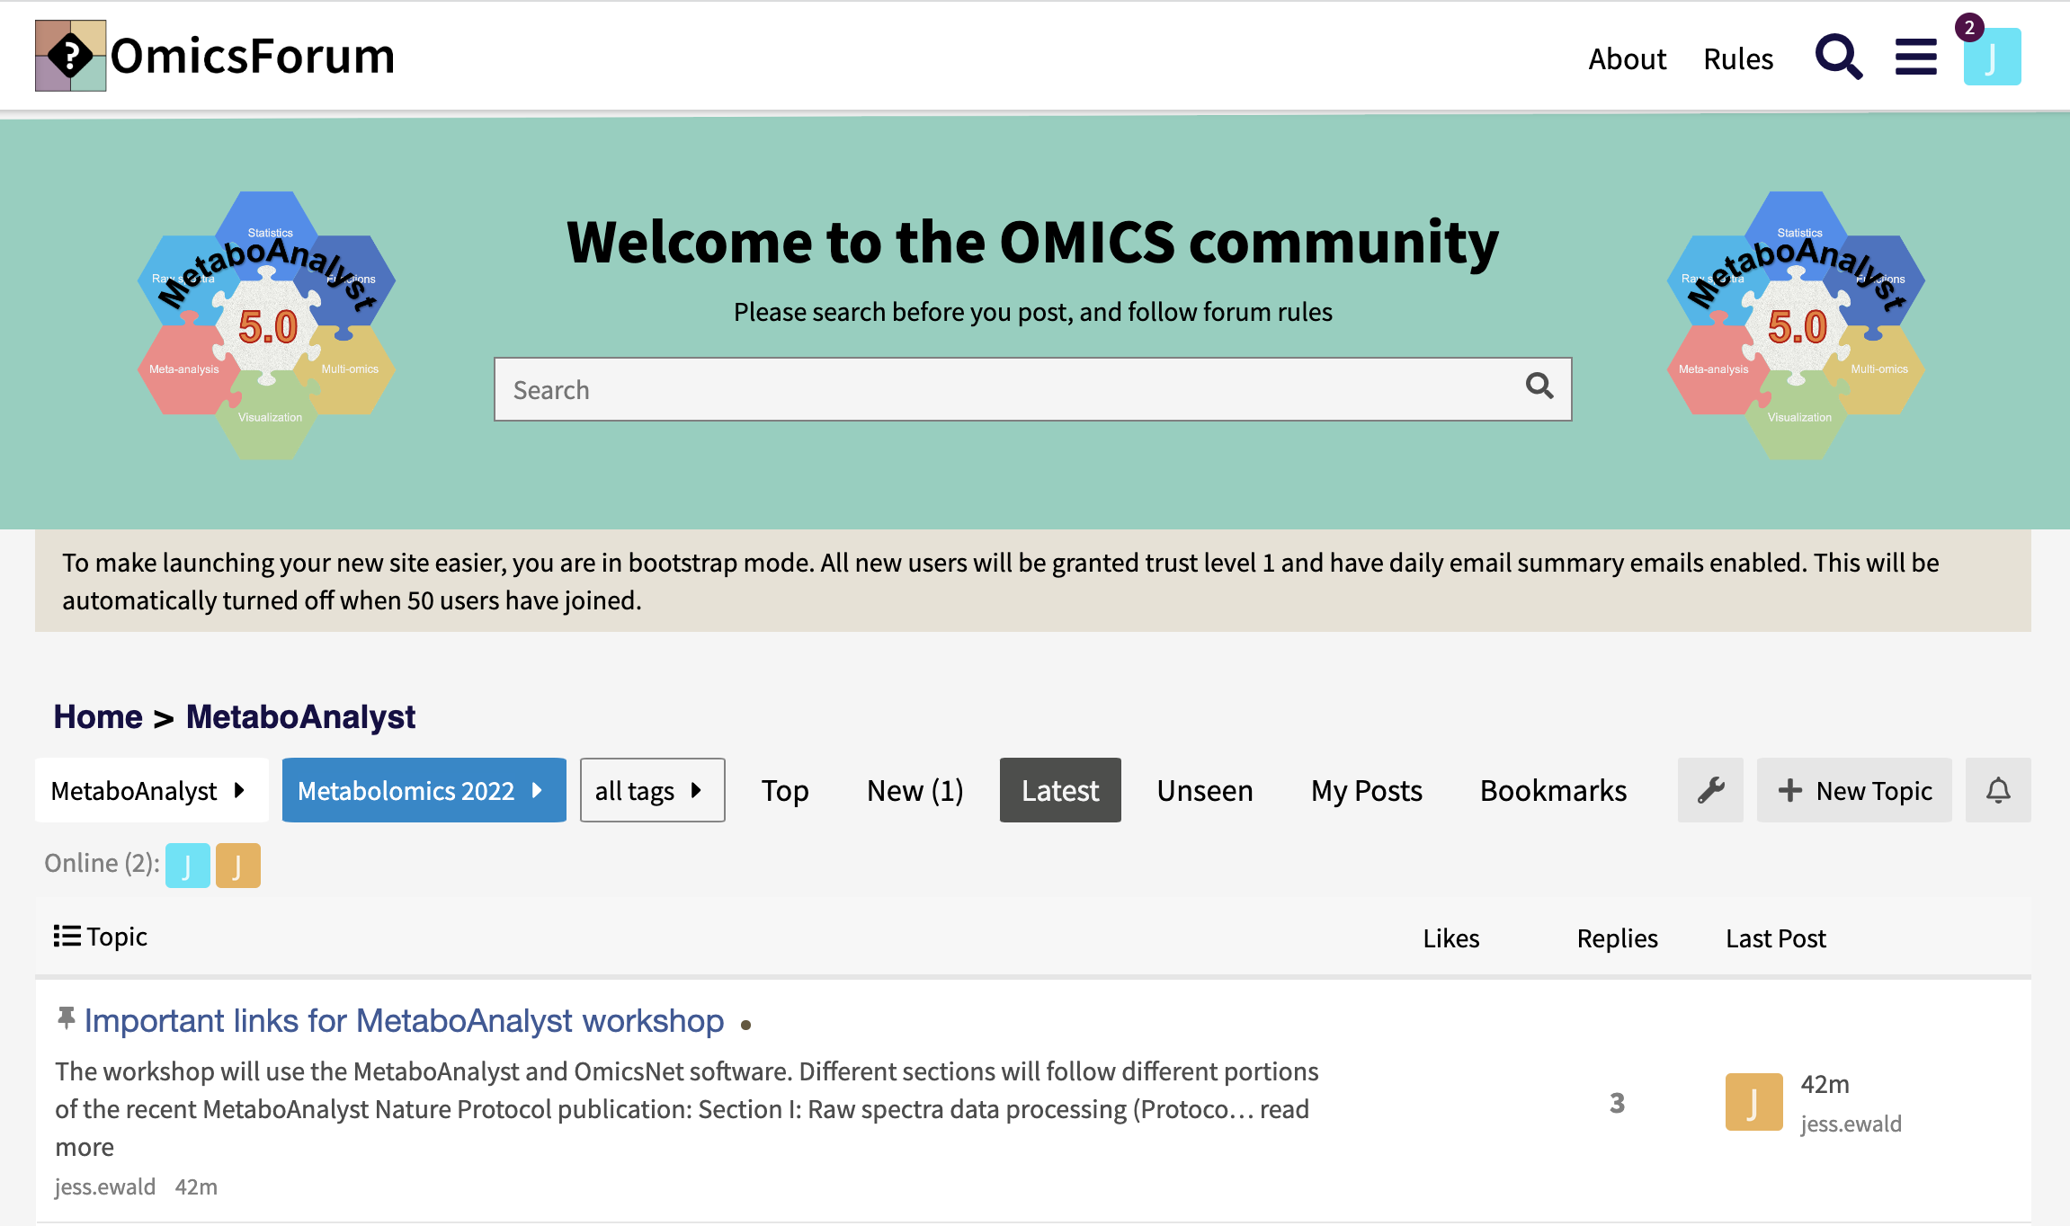
https://omicsforum.ca
Current topics in MetaboAnalyst: ~700
Please search topics or open a new topic

Slide 21
Schedule
Part I: 8:15 AM – 10:15 PM
8:15 – 8:30: Opening lecture (Jeff)
8:30 – 8:50: Section 1: LC-MS spectral processing (Qiang)
8:50 – 9:15: Section 1: Hands on
9:20 – 9:45: Section 2: Stats I – simple experimental design (Jessica)
9:45 – 10:15: Section 2 Hands on
Part II: 10:30 AM – 12:30 PM
10:30 – 10:50: Section 3: Functional analysis (Yao)
10:50 – 11:10: Section 3: Hands on
11:15 – 11:40: Section 4: Stats II - complex experimental design (Jessica)
11:40 – 12:15: Section 4: Hands on
12:15 – 12:30: Summary (Jeff)

